Slide 1
Unit 2 Live Session
Ben Goodwin

Slide 2
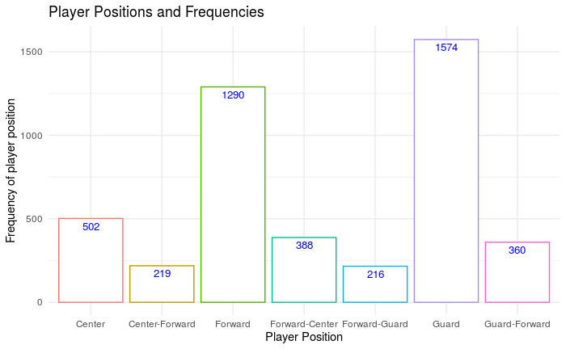
Plot 1, players and their positions

Slide 3
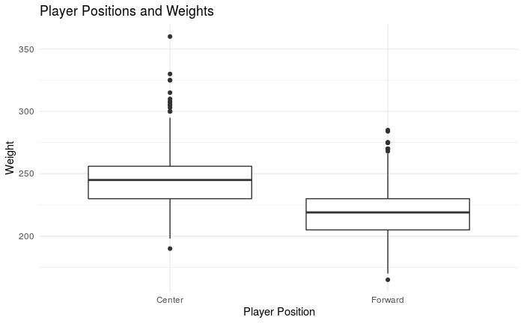
Plot 2, Weight of Centers and Forwards

Slide 4
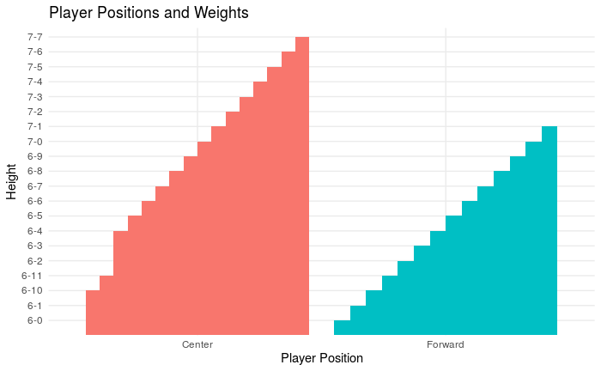
Plot 3, Heights of Centers and Forwards

Slide 5
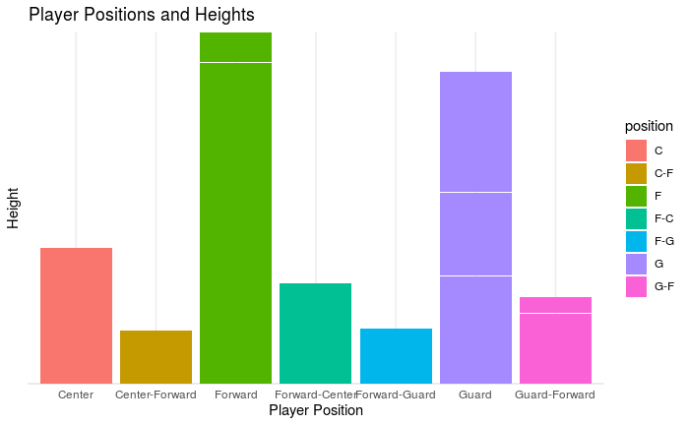
Plot 4, Position Heights

Slide 6
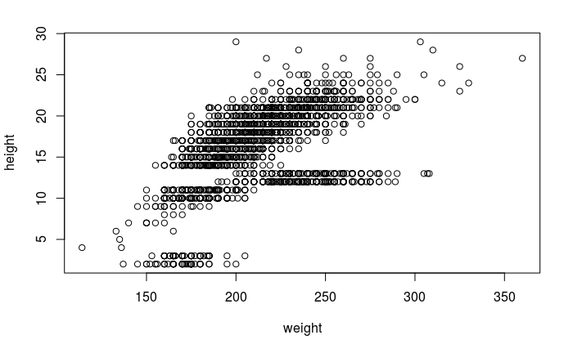
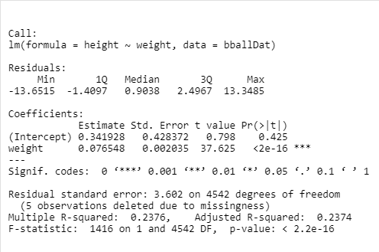
Height VS Weight
From a linear model, we see some support in favor of weight and height being related.

Slide 7
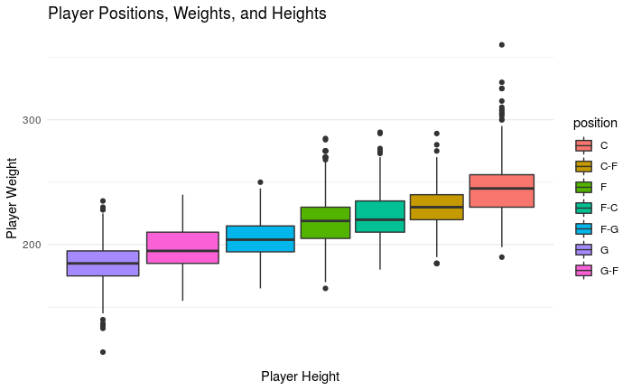
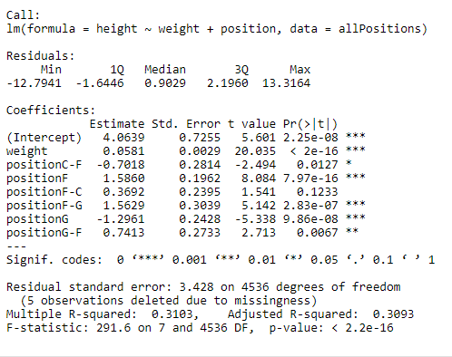
Height and Weight for different Positions

Slide 8
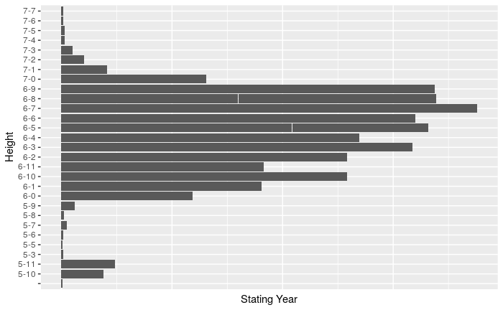
Height and Starting Year

Slide 9
3D Plot of Height vs. Weight vs. Year and color code the points by position

Slide 10
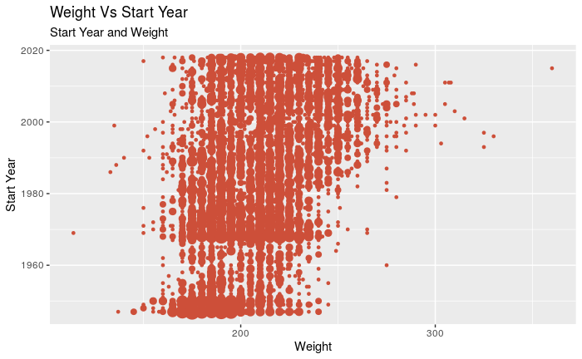
Start Year Vs Weight

